Slide 1
Quantum physics

Slide 2
Quantum physics grew out failures of classical physics which found some quantum remedies in the Planck hypothesis and wave-particle duality and generated new ideas like the Uncertainty principle and Quantum statistics. Quantum physics is launched by experiments such as Photoelectric effect and Black body radiation.

Slide 3
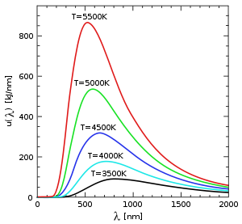
Thermal radiation
Thermal radiation is electromagnetic radiation generated by the thermal motion of charged particles in matter. All matter with a temperature greater than absolute zero emits thermal radiation.
This diagram shows how the peak wavelength and total radiated amount vary with temperature. Although this plot shows relatively high temperatures, the same relationships hold true for any temperature down to absolute zero. Visible light is between 380 and 750 nm.

Slide 4
Sunlight is thermal radiation generated by the hot plasma of the Sun. The Earth also emits thermal radiation, but at a much lower intensity and different spectral distribution because it is cooler.
If a radiation-emitting object meets the physical characteristics of a black body in thermodynamic equilibrium the radiation is called blackbody radiation. Planck's law describes the spectrum of blackbody radiation, which depends only on the object's temperature.
u(ν,T) is known as the black body spectrum. It is a spectral energy density function with units of energy per unit frequency per unit volume.
Wien's displacement law determines the most likely frequency of the emitted radiation
where λ_{max} is the peak wavelength, T is the absolute temperature of the black body, and b is a constant of proportionality called Wien's displacement constant

Slide 5
The Stefan–Boltzmann law, also known as Stefan's law, states that the total energy radiated per unit surface area of a black body per unit time (known variously as the black-body irradiance energy flux density, radiant flux or the emissive power), j*, is directly proportional to the fourth power of the black body's thermodynamic temperature T (also called absolute temperature):

