Slide 2
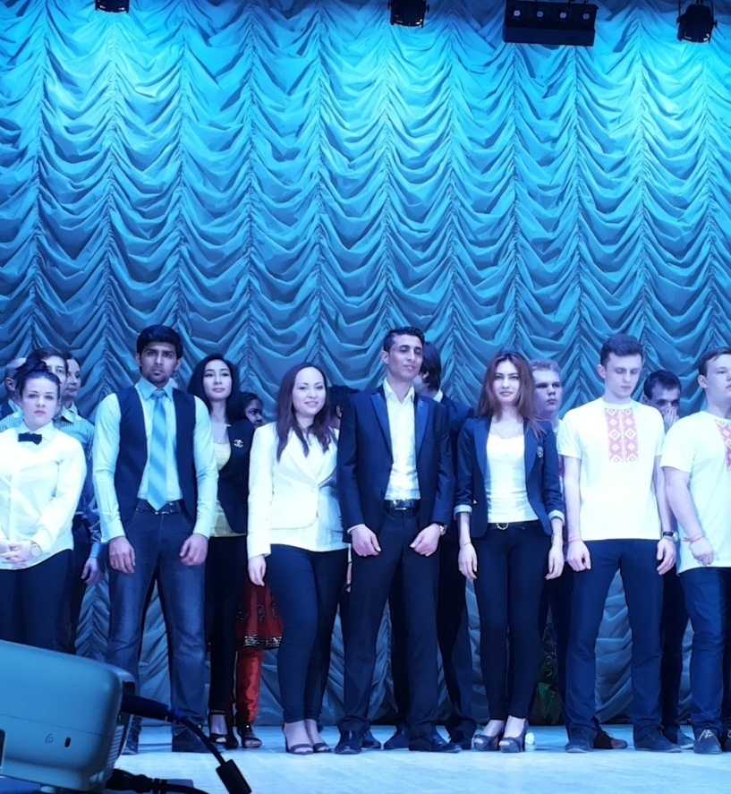
TEAM KVN «ALI-BABASHKI» Faculty of Foreign Students

Slide 3
Leader of the team– Aljazaa Hamed

Slide 9
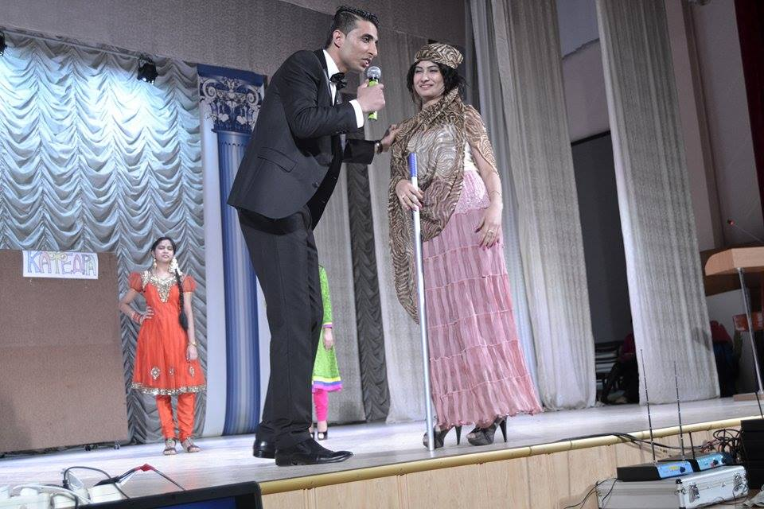

Slide 11
